Slide 1

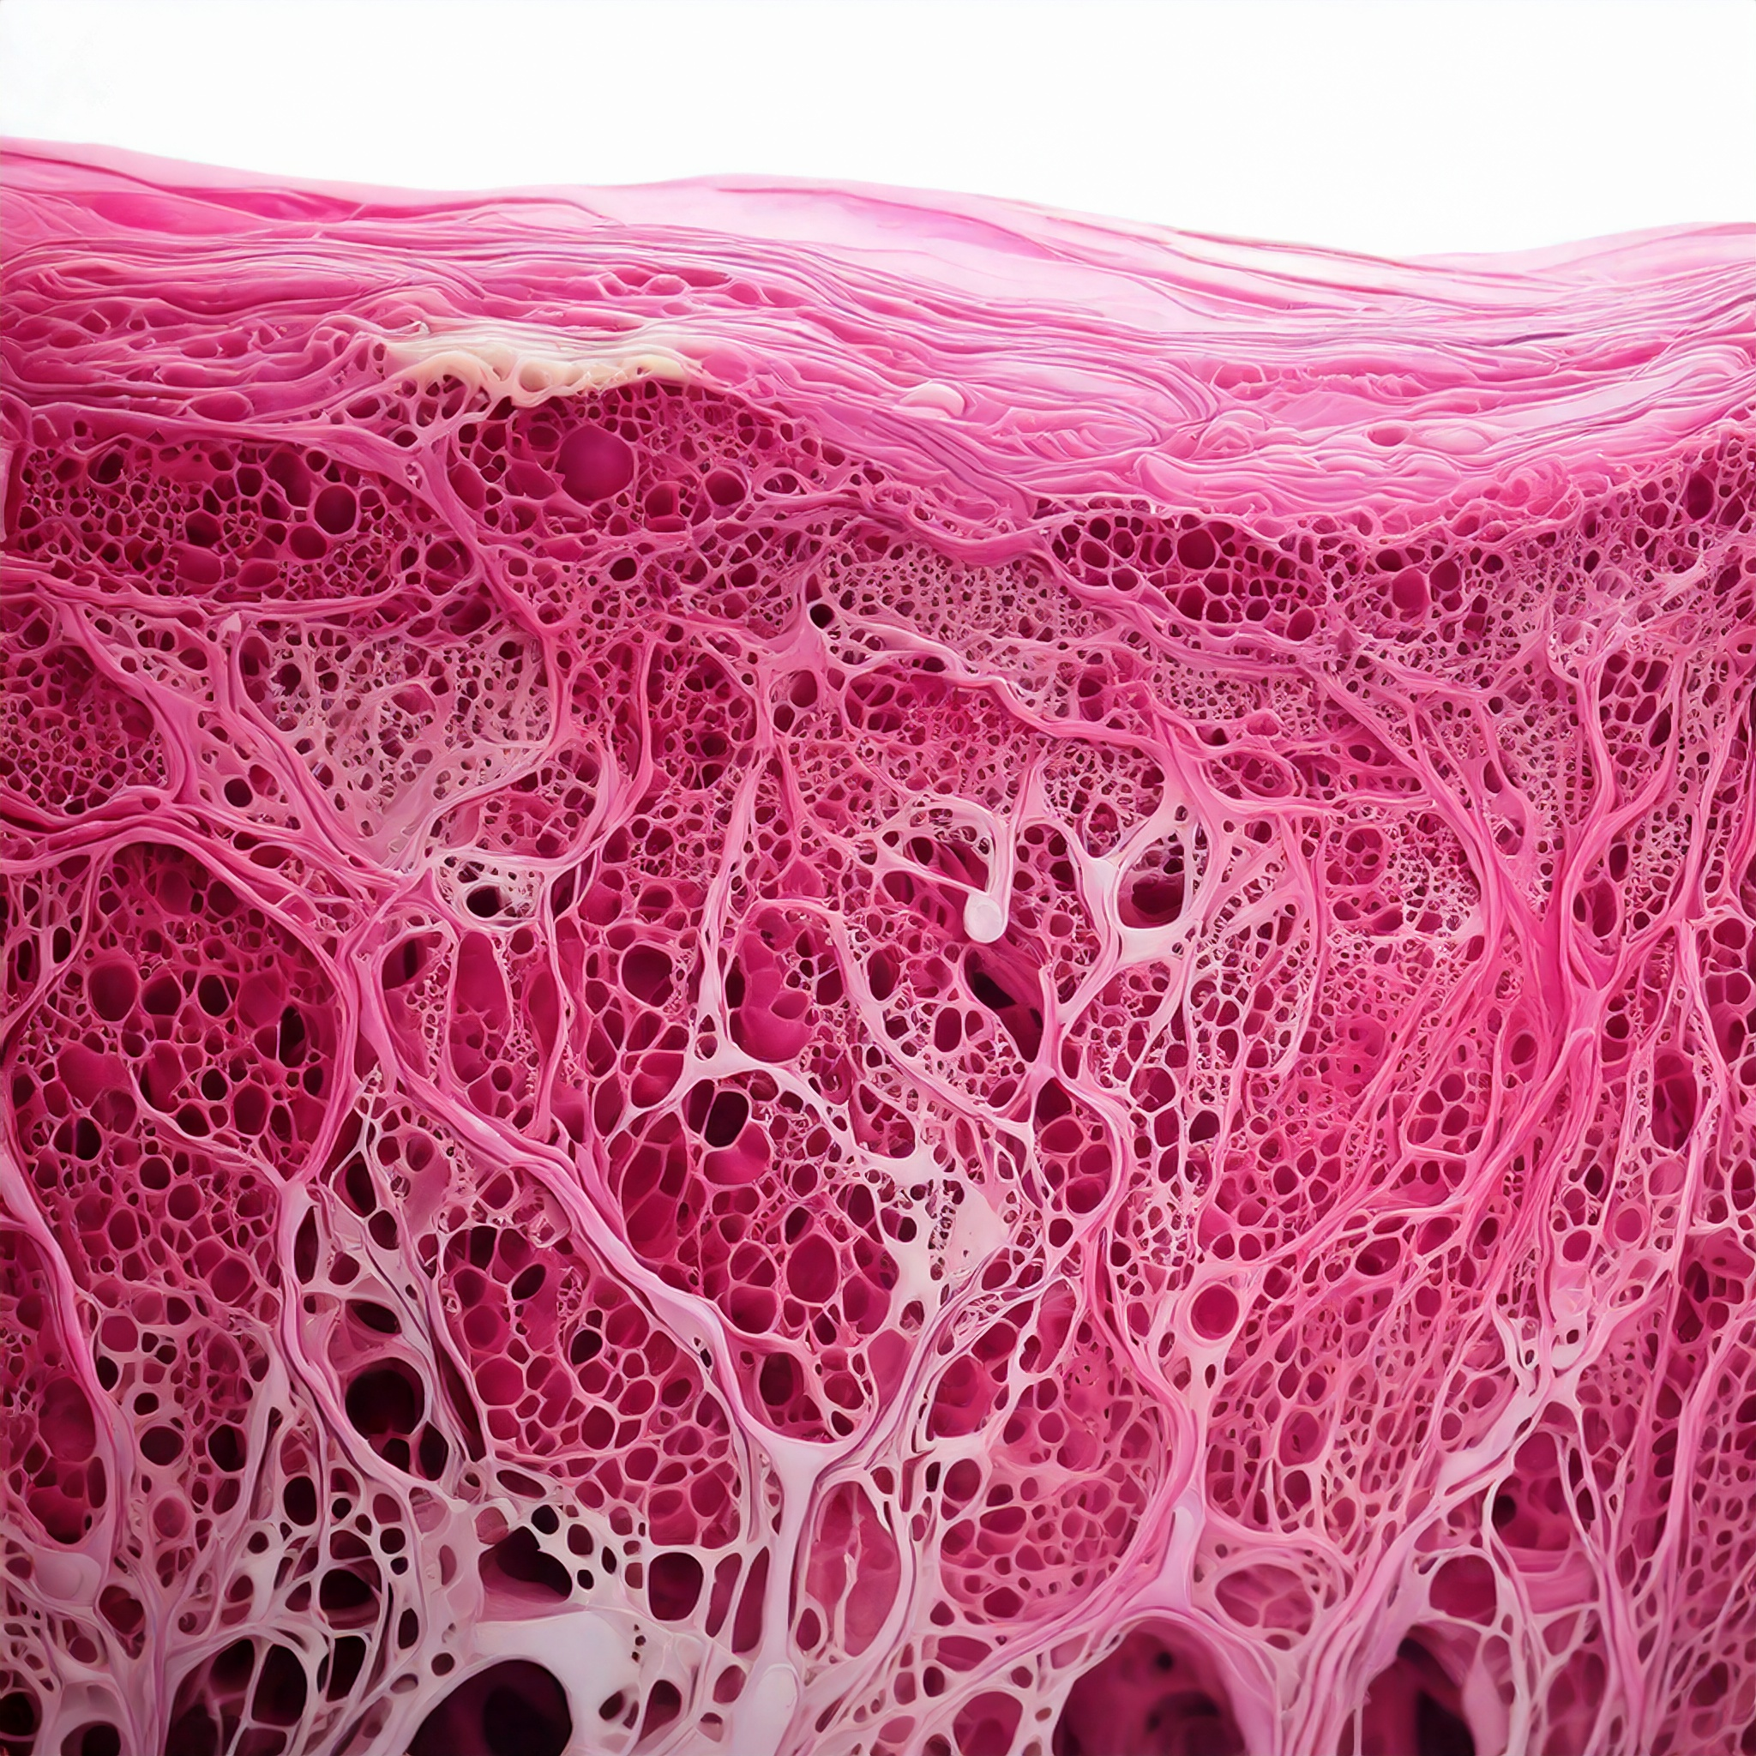
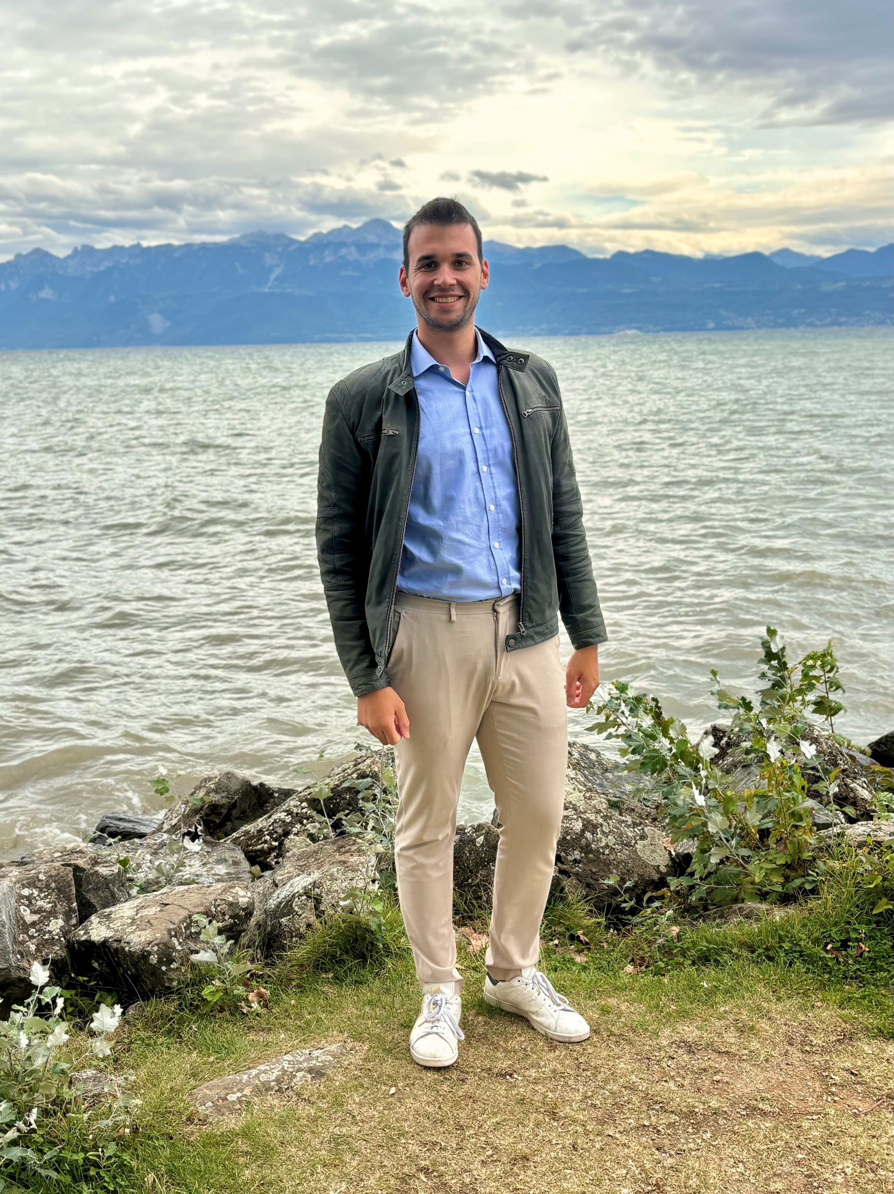

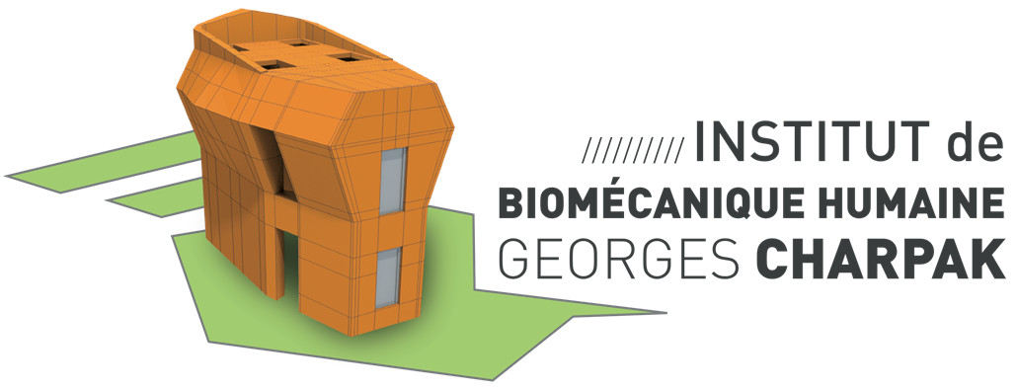
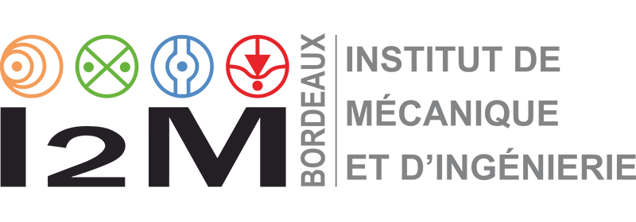
Thomas Lavigne – Docteur en Sciences de l’Ingénieur
Thomas LAVIGNE
Biomechanical Response of Human Skin: A Hierarchical Porous Media Framework.
Supervisors
Pr. S. Bordas, Dr. P-Y. Rohan, Dr. G. Sciumè
AFR-FNR 17013182

Slide 2

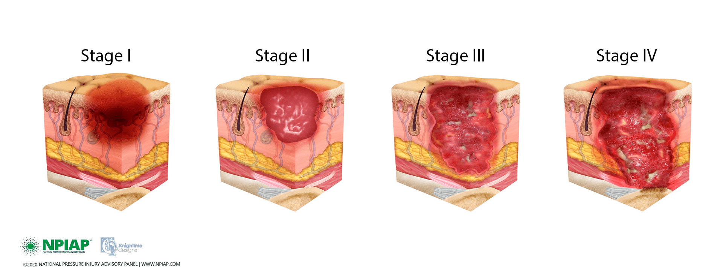












Still millions of pressure ulcers
[Vanderwee et al., 2007]
[Ayello 2008; Parvizi et al. 2023]

Slide 3

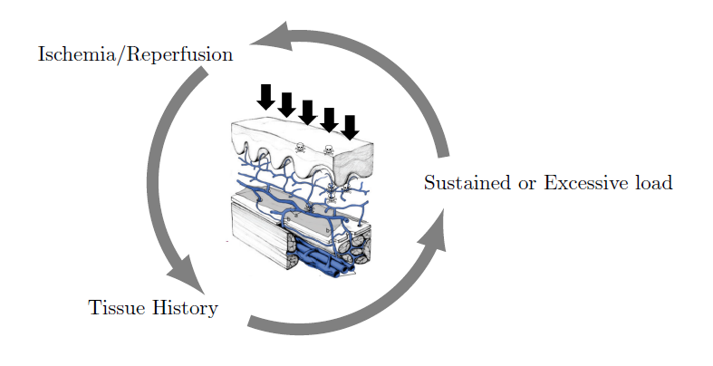
Clinical research
Oxygen deprivation
External forces
State of the tissue

Slide 4

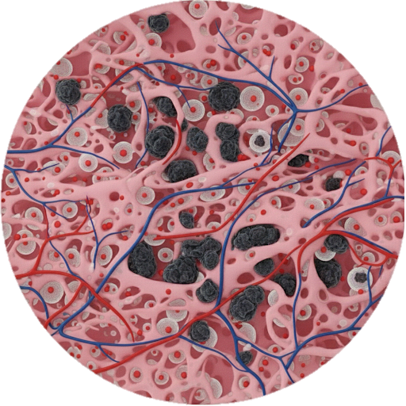

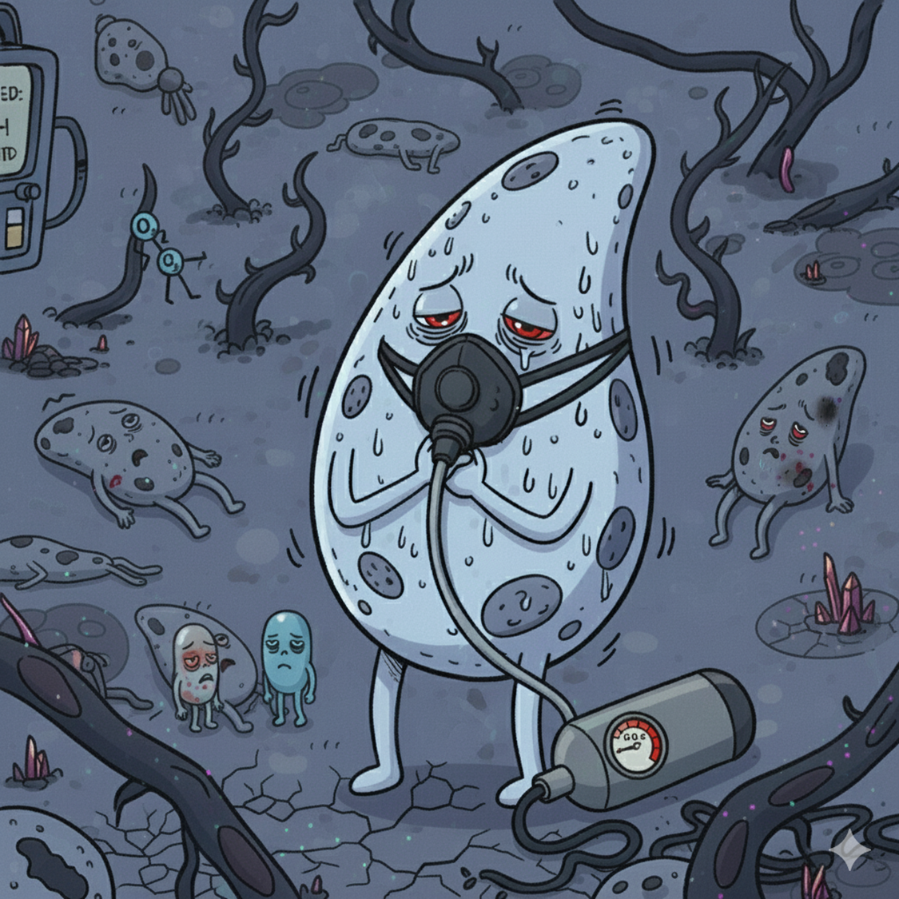

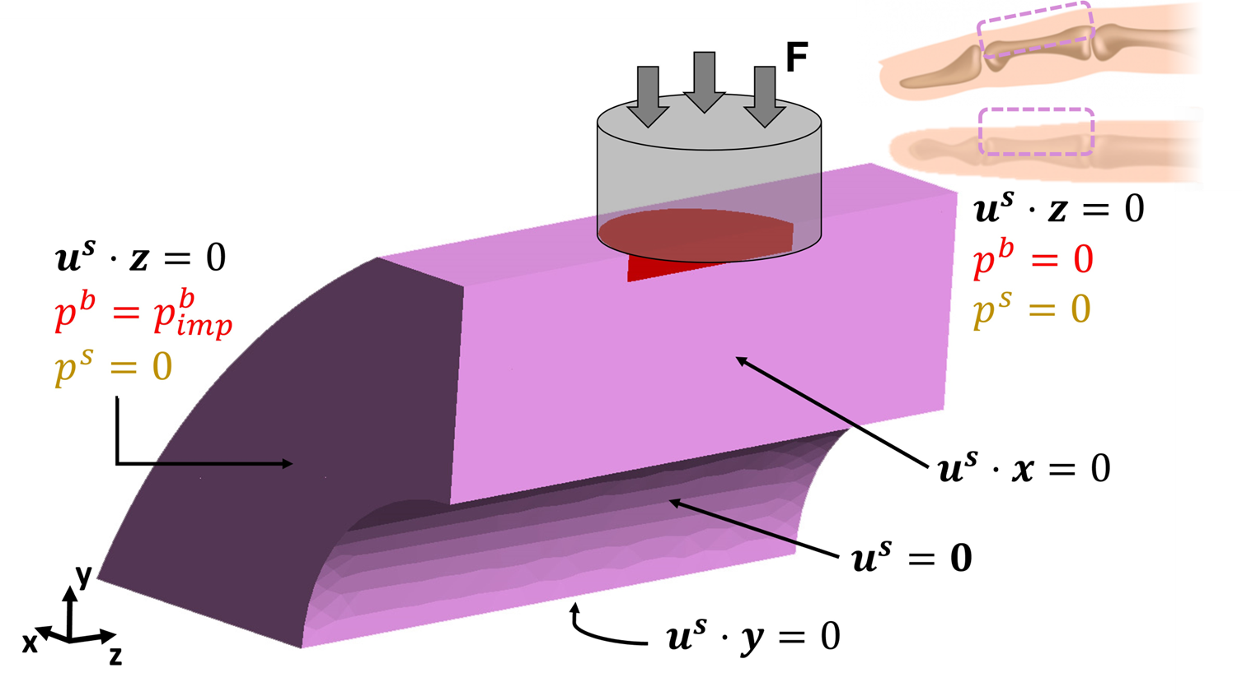
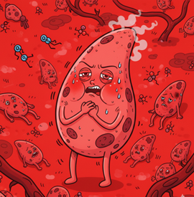

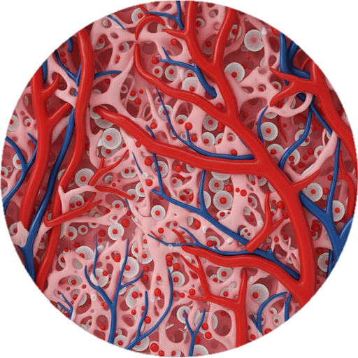
Clinical research: interplay ?
Oxygen deprivation
External forces
State of the tissue

Slide 5

Coupling Biology and Mechanics
Oxygen deprivation
External forces
State of the tissue

Slide 6
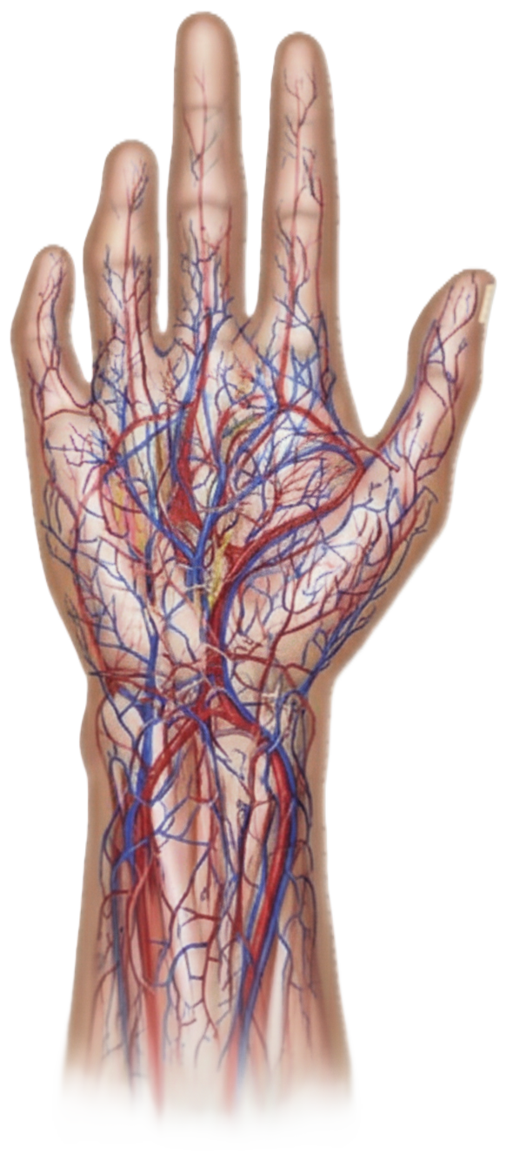
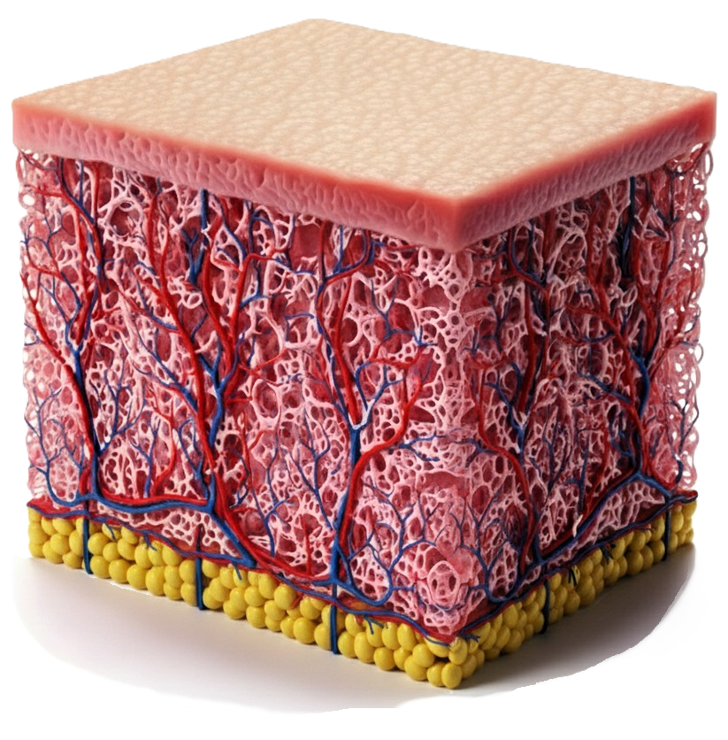
The Human skin as a sponge
Macroscale
Stratified
Fibrous
60% of water
[Burns et al., 2010]
Some images are AI generated

Slide 7
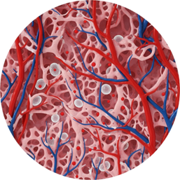
The Human skin as a sponge
Microscale
Interstitial fluid
Mobile cells
Structural cells and other structures
Connective tissue
Micro-vascular system = oxygen supply
Some images are AI generated

Slide 8
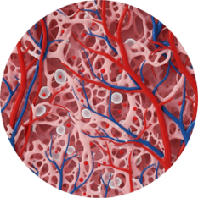
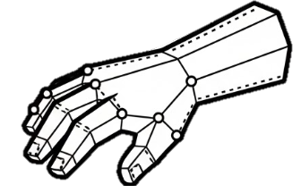
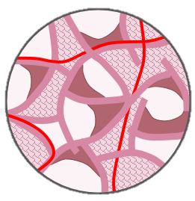



The Porous (bricks) Model
Conservation Laws
Constitutive Laws
Mass Conservation
Solid
Stress-Strain law
How does it work?
Increasing force on the solid
Increased pressure in the pores
Squeezed blood vessels
Solid
Cells
Oxygen
Pores
IF
Blood
IF pressure / Cell Saturation
F(x, p^{α}) =
Force Equilibrium
Vascular phase
Porosity
Permeability
Total stress
Darcy Blood
Oxygen
Darcy IF
Darcy Cells
Diff. Oxygen
Abs. Oxygen
[Lavigne et al. 2023, 2025a, 2025b , 2025c]

Slide 9
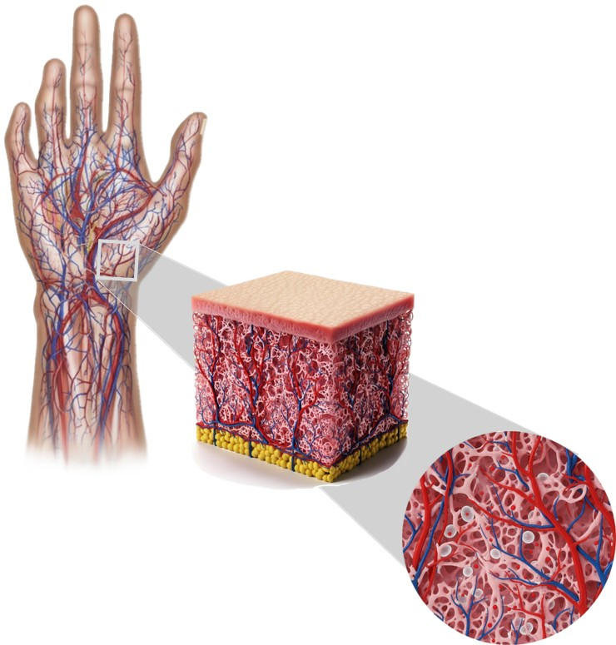
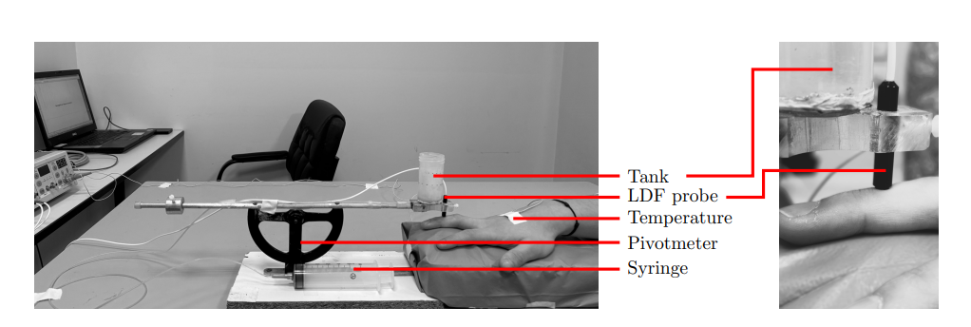
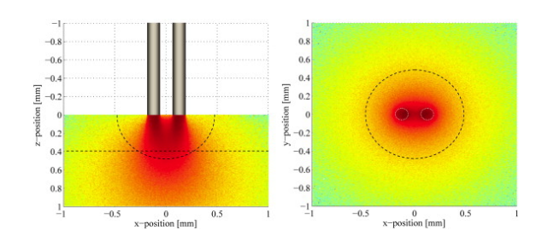
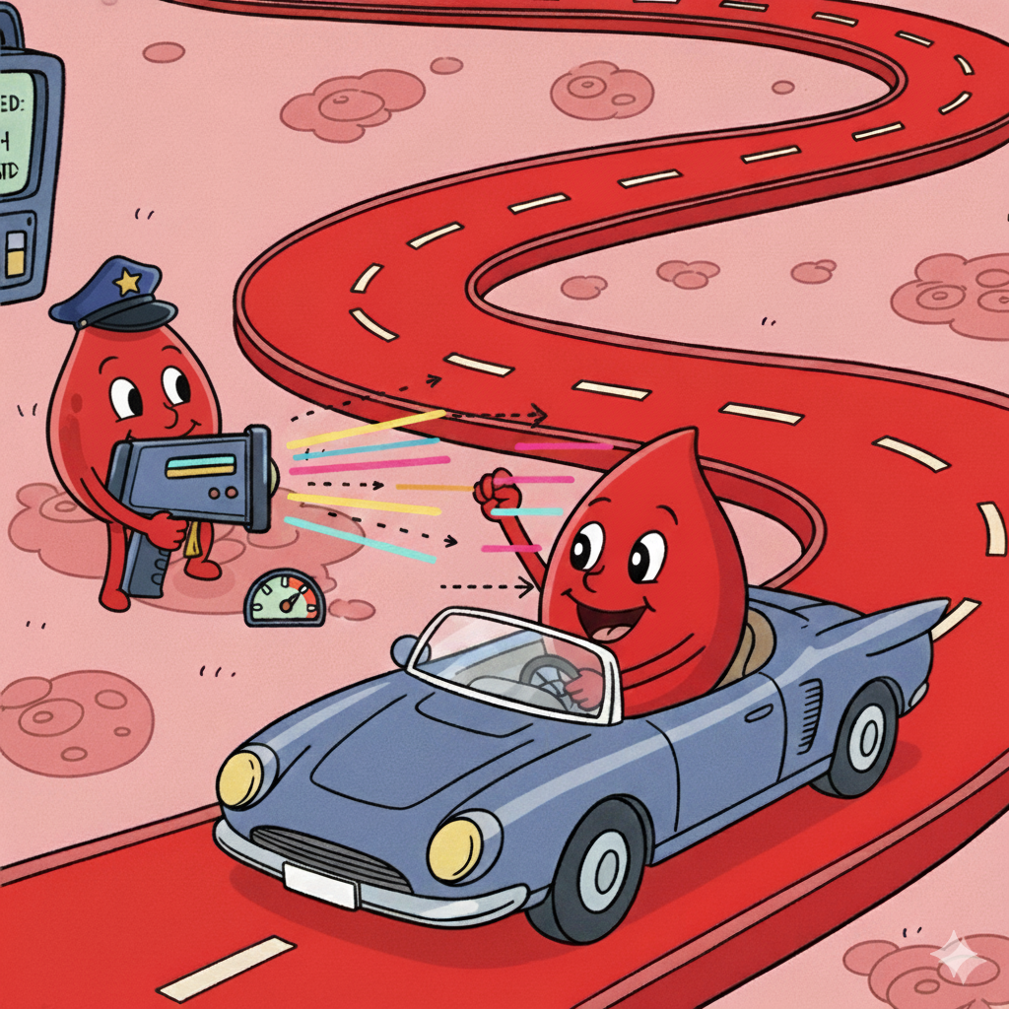

Experimental setup
[Fredriksson et al., 2009]
N= 11 N= 10
Some images are AI generated

Slide 10
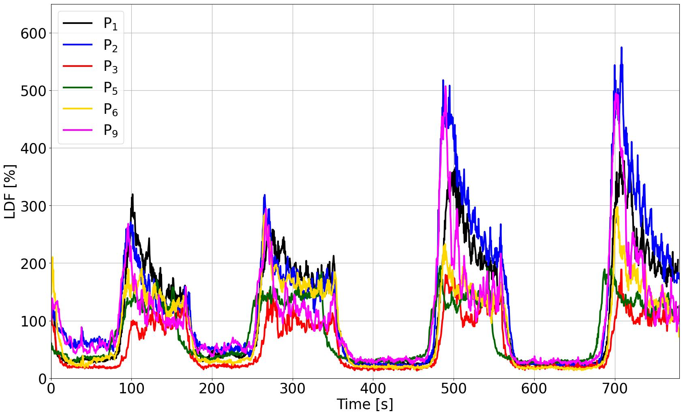
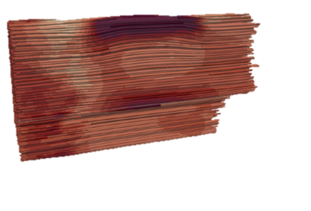
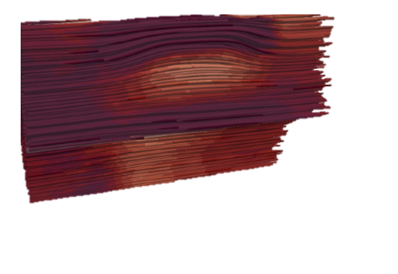
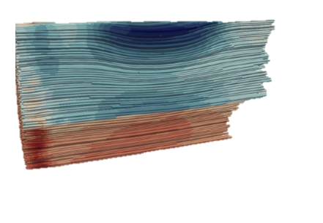
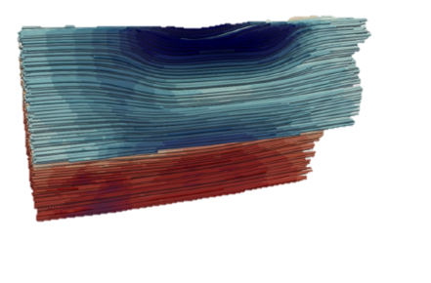
Model vs Patient data
Ischaemia (Hypoxia)
Hyperemia (Oxydation – Water-hammer pulse)
Some images are AI generated

Slide 11


Perspectives
Towards Personnalized Treatment
Conservation Laws
Constitutive Laws
Mass Conservation
Solid
Solid
Cells
Oxygen
Stress-Strain law
IF
Blood
Interstitium
F(x, p^{α}) =
IF pressure / Cell Saturation
Force Equilibrium
Vascular phase
Total stress
Darcy Blood
Porosity
Permeability
Darcy IF
Darcy Cells
Oxygen
Diff. Oxygen
Abs. Oxygen
Some images are AI generated
✔ Hierarchical and Modular porous framework,
✔ Ischaemia and PORH were obtained with mechanics only,
✔ Open-source implementation,
✔ Transferable: plantar foot, brain, tissue engineering, drug delivery, ➪ Biological integration should be compared to experimental campaigns,
➪ For pressure ulcers prevention, damage and remodelling should be introduced,

Slide 13

Ayello, C. H. L. E. A. (2008). “Patient Safety and Quality: An Evidence-Based Handbook for Nurses.” In: NIH. Chap. 12.
Lavigne, T., S. Urcun, P.-Y. Rohan, G. Sciumè, D. Baroli, and S. P. Bordas (2023). “Single and bi-compartment poro-elastic model of perfused biological soft tissues: FEniCSx implementation and tutorial”. In: Journal of the Mechanical Behavior of Biomedical Materials 143, p. 105902
Lavigne, T., S. Urcun, E. Jacquet, J. Chambert, A. Elouneg, C. A. Suarez-Afanador, S. P. A. Bordas, G. Sciumè, and P.-Y. Rohan (2025a). Poromechanical modelling of the time-dependent response of in vivo human skin during extension. In: International Journal for Numerical Methods in Biomedical Engineering.
Lavigne, T., S. Urcun, B. Fromy, A. Josset-Lamaugarny, A. Lagache, C. A. Suarez-Afanador, S. P. A. Bordas, P.-Y. Rohan, and G. Sciumè (2025b). “Hierarchical poromechanical approach to investigate the impact of mechanical loading on human skin micro-circulation”. In: International Journal for Numerical Methods in Biomedical Engineering.
Lavigne T, Biomechanical Modeling of Human skin: a Hierarchical Porous Media Framework. PhD, Biomechanical Response of Human Skin : A Hierarchical Porous Media Framework. | Theses.fr
Fredriksson, I., M. Larsson, and T. Strömberg (2009). “Measurement depth and volume in laser Doppler flowmetry”. In: Microvascular Research 78.1, pp. 4–13.
Parvizi, A., S. Haddadi, A. Mollaei, P. Ghorbani Vajargah, P. Takasi, M. Firooz, S. J. Hosseini, R. Farzan, and S. Karkhah (2023). “A systematic review of nurses’ knowledge and related factors towards the prevention of medical device-related pressure ulcers”. In: International Wound Journal 20.7, pp. 2843–2854.
Vanderwee, K., M. Clark, C. Dealey, L. Gunningberg, and T. Defloor (2007). “Pressure ulcer prevalence in Europe: a pilot study”. In: Journal of Evaluation in Clinical Practice 13.2, pp. 227–235

Slide 14
Biomechanical Response of Human Skin: A Hierarchical Porous Media Framework.
Thomas Lavigne
Supervisors: S. Bordas, P-Y. Rohan, G. Sciumè Jury and guests: C. Vincenot, S. Avril, Y. Payan, S. Budday, S. Laporte
AFR-FNR 17013182
Notes:
10 seconds
Good afternoon, everyone. My name is Thomas Lavigne, and I'm here today to present my work on the Biomechanical Response of Human Skin, specifically through the lens of a Hierarchical Porous Media Framework.

Slide 15
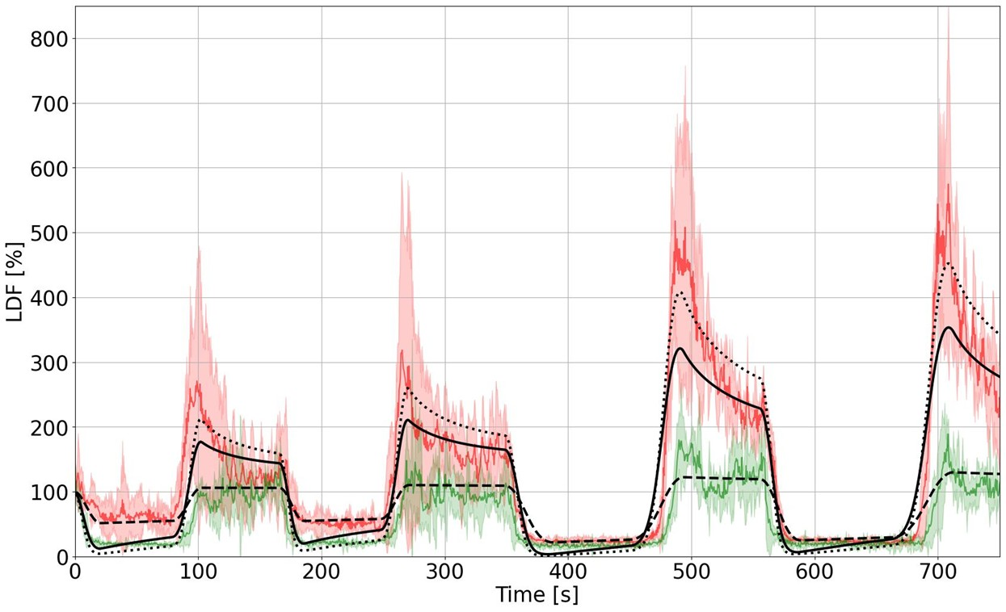
Evaluation with patient data
Notes:
Interestingly, the model was capable of representing both ischaemia and hyperemia, without any neurological considerations.

